Slide 1
Secure Data Hiding in images using steganography
CAPSTONE PROJECT
Presented By: Utsav Desai
Student Name : Utsav Desai
College Name & Department : Sarvajanik College Of Engineering and Technology

Slide 2
OUTLINE
Problem Statement
Technology used
Wow factor
End users
Result
Conclusion
Git-hub Link
Future scope

Slide 3

Problem Statement
Context: In an era where digital communication is ubiquitous, the need for secure transmission of sensitive information has become paramount. Traditional encryption methods, while effective, often reveal the existence of the message itself, making it vulnerable to interception.
Challenge: How can we securely transmit information without drawing attention to the fact that communication is taking place? This project addresses the challenge of hiding data within innocuous-looking images, ensuring both confidentiality and stealth.

Slide 4
Technology used
Programming Languages:
Python: Chosen for its simplicity and extensive libraries for image processing.
Libraries/Frameworks:
OpenCV: For image manipulation and processing.
NumPy: For efficient numerical operations and data handling.
Pillow: For image creation and editing in Python.
Techniques:
Least Significant Bit (LSB) Method: A widely used technique where the least significant bits of pixel values are replaced with bits of the secret message.
Discrete Cosine Transform (DCT): Used in JPEG images to embed data in the frequency domain, making it more robust against compression.
Masking and Filtering: Techniques to enhance the invisibility of the hidden data.

Slide 5

Wow factors
Data Capacity: The project can hide large volumes of data within images without noticeable degradation in quality, making it suitable for various applications.
Real-Time Processing: Users can encode and decode messages in real-time, facilitating immediate communication.
User -Friendly Interface: The application features an intuitive GUI that allows users to easily select images, input messages, and retrieve hidden data. For this I used Tkinter python library.
Cross-Platform Compatibility: The project can be run on multiple operating systems, enhancing accessibility for users.

Slide 6
End users
Individuals: Journalists, activists, and whistleblowers who require secure communication channels to protect sensitive information.
Organizations: Corporations, financial institutions, and healthcare providers that need to safeguard proprietary data and patient information.
Developers and Researchers: Those interested in cybersecurity, data protection, and digital forensics can utilize the project as a foundation for further research and development.

Slide 7
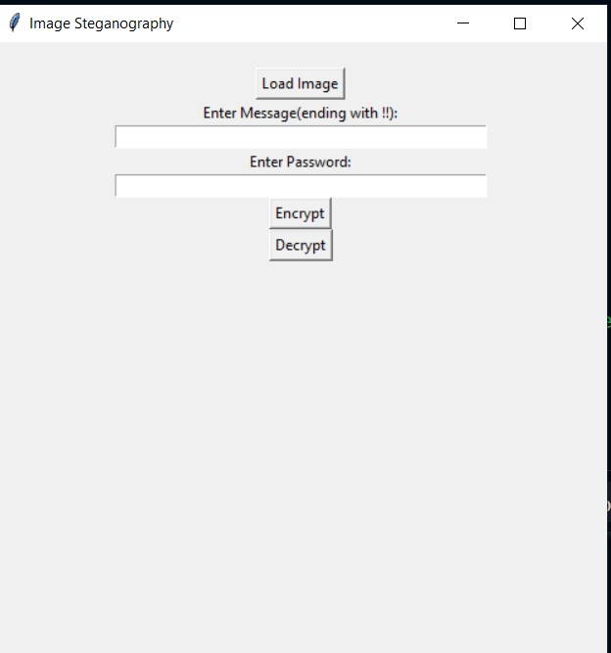
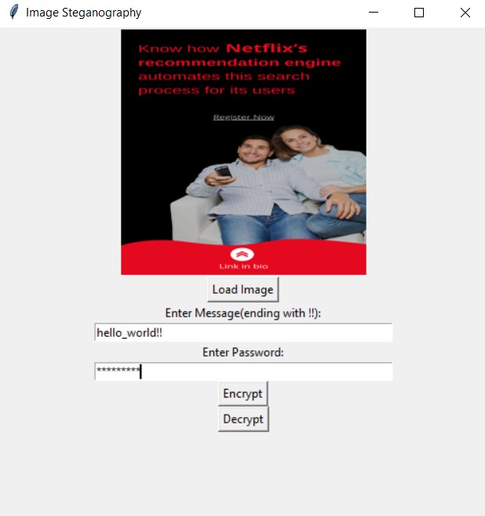
Results

Slide 8
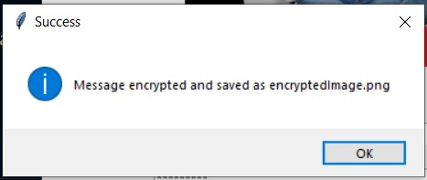
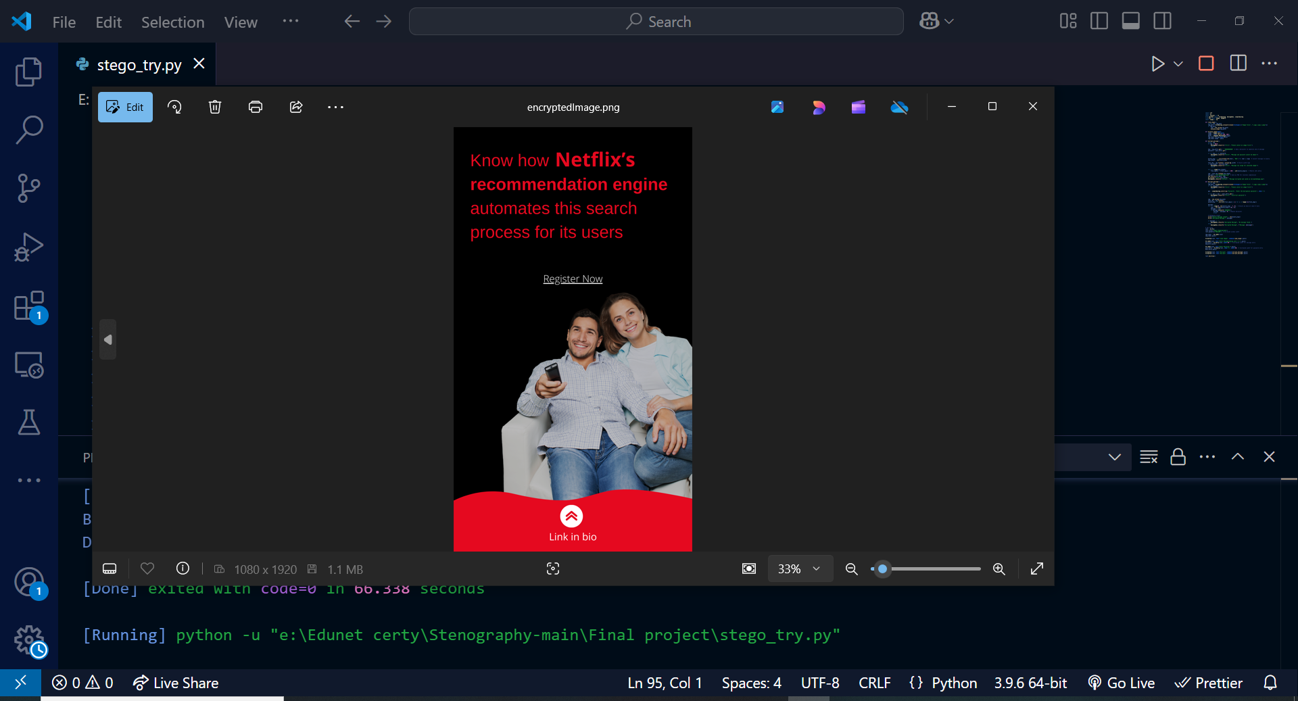
Results

Slide 9
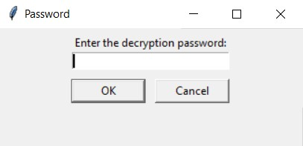
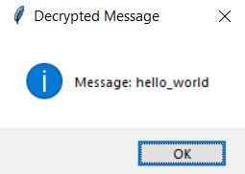
Results

Slide 10
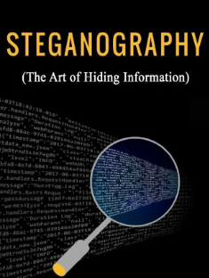
Conclusion
Significance of Steganography: The project underscores the importance of steganography as a complementary technique to traditional cryptography, providing an additional layer of security.
Future Implications: As digital threats evolve, the need for innovative data protection methods like steganography will continue to grow, making this project relevant and impactful.

Slide 11
GitHub Link
https://github.com/Utsav199/Steganography-project.git

Slide 12
Future scope(optional)
Advanced Techniques: Investigate adaptive steganography methods that adjust based on the content of the image to enhance data hiding capabilities.
Multimedia Applications: Extend the project to include audio and video steganography, allowing for a broader range of data hiding techniques.
Mobile Application Development: Create a mobile app that enables users to send and receive hidden messages securely on their smartphones.
Integration with Blockchain: Explore the potential of combining steganography with blockchain technology for secure and verifiable communication.

Slide 13
THANK YOU

